Slide 1
106TH INDIAN SCIENCE CONGRESS (ISCA) LOVELY PROFESSIONAL UNIVERSITY, PHAGWARA, JALANDHAR January 3-7, 2019
Participation by II M.Sc. Zoology Students
L

Slide 2
LOVELY PROFESSIONAL UNIVERSITY, PHAGWARA, JALANDHAR

Slide 3
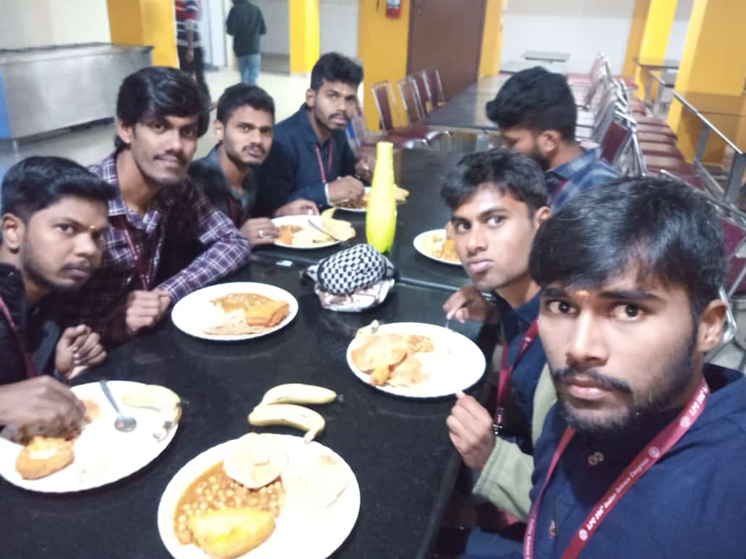
LOVELY PROFESSIONAL UNIVERSITY, PHAGWARA, JALANDHAR
Meals at the Cafetaria

Slide 4
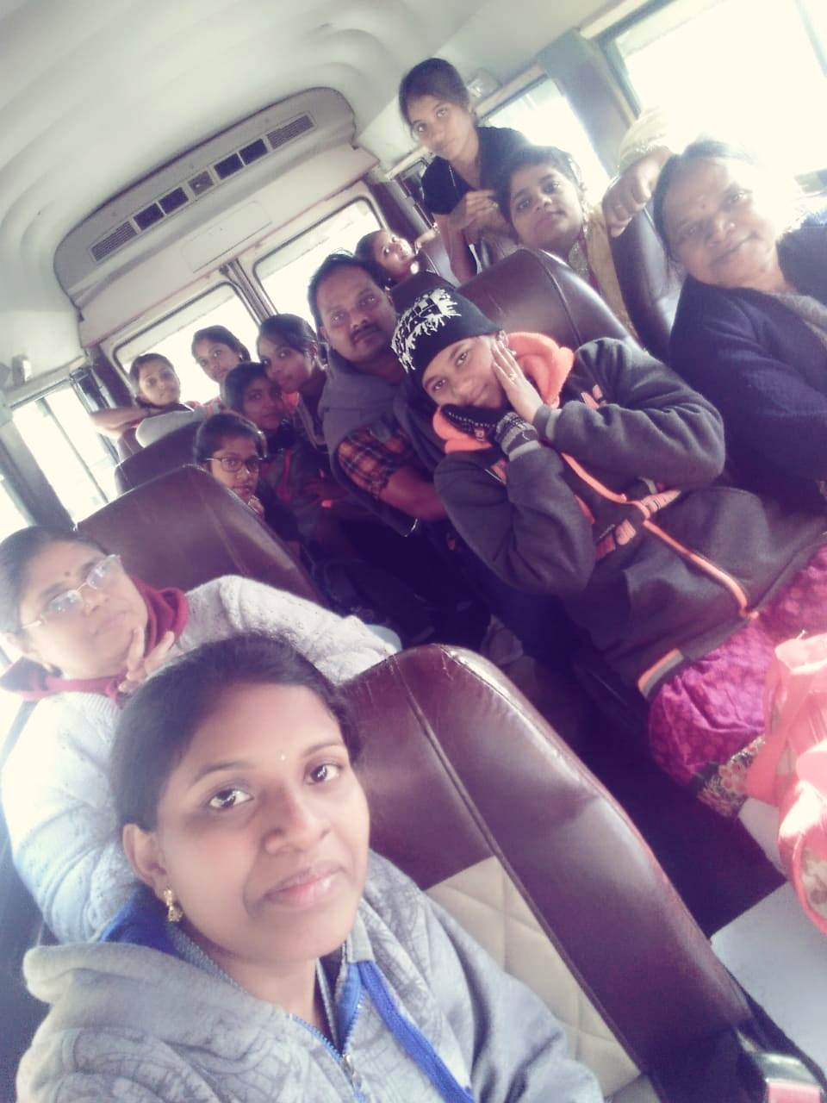
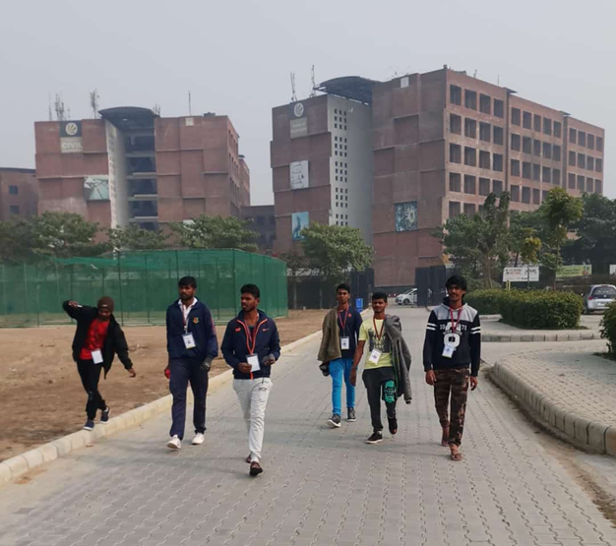
LOVELY PROFESSIONAL UNIVERSITY, PHAGWARA, JALANDHAR
On the Way to the
Conference Venue

Slide 5
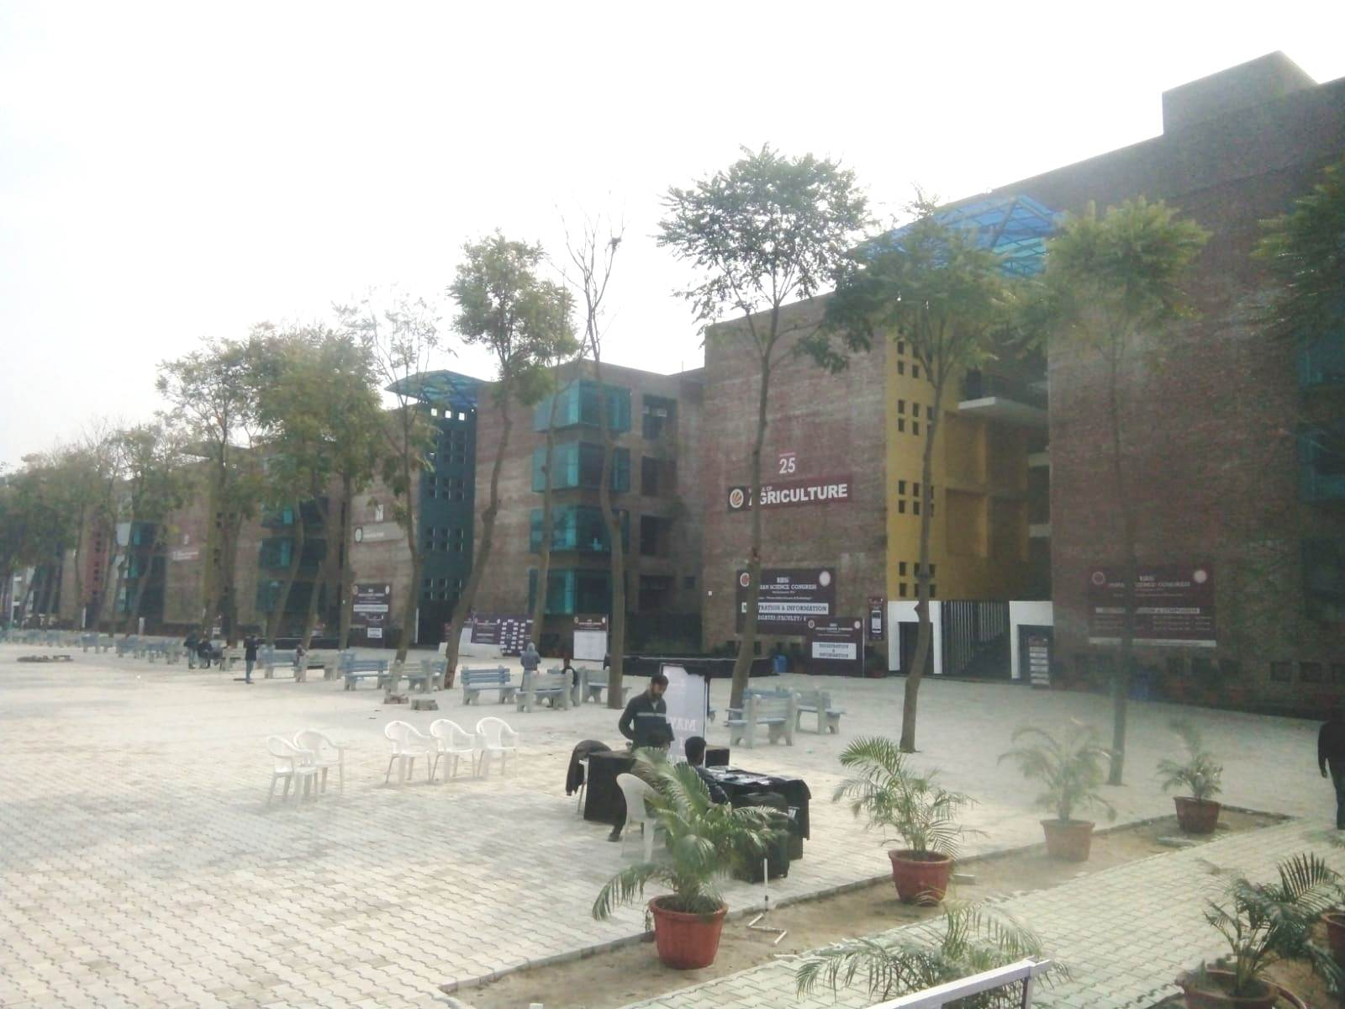
LOVELY PROFESSIONAL UNIVERSITY, PHAGWARA, JALANDHAR
Conference Venue

Slide 6
106th Indian Science Congress

Slide 7
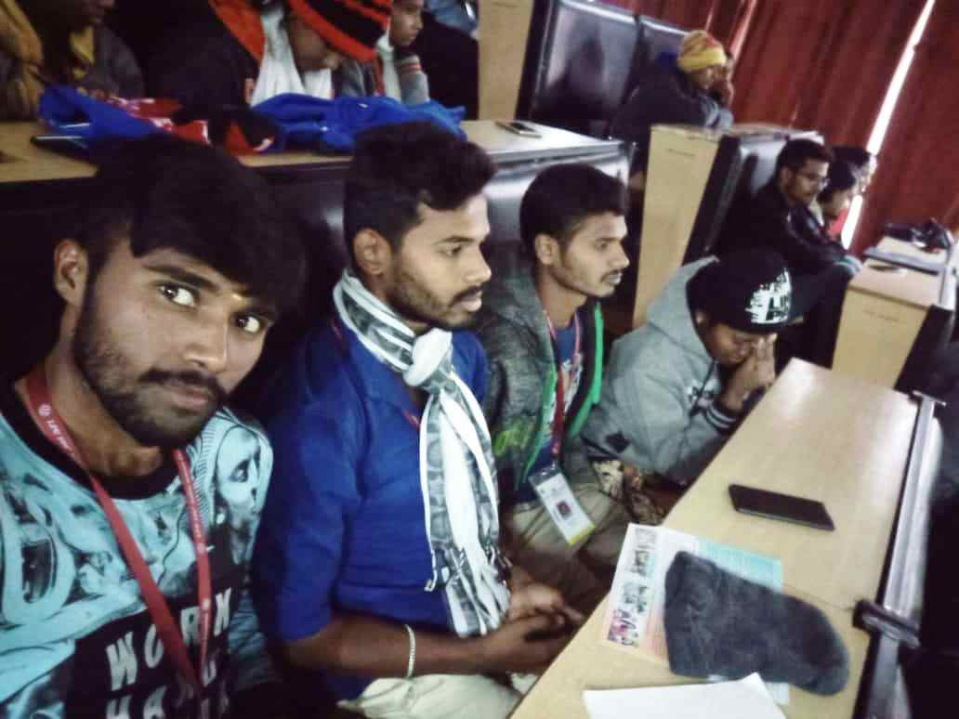
106th Indian Science Congress
At the Conference

Slide 8
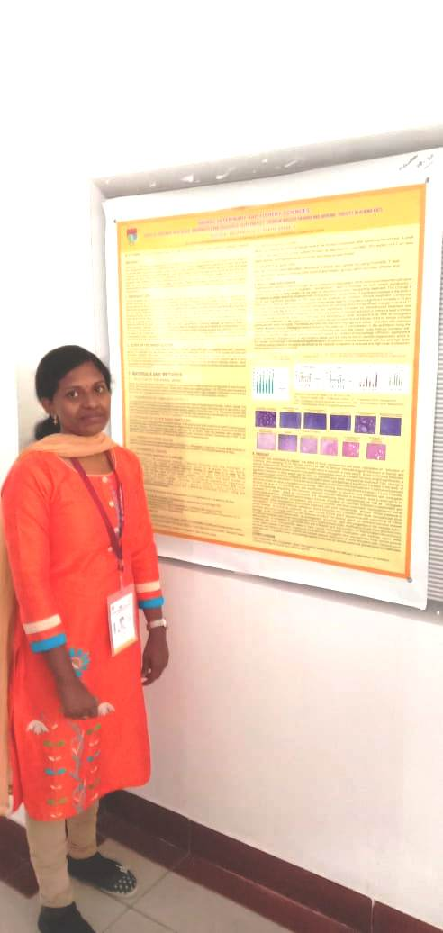
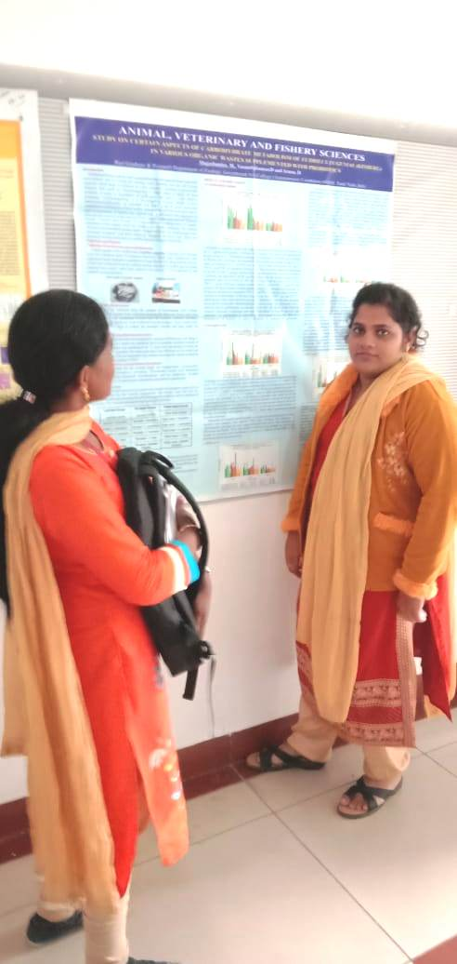
106th Indian Science Congress
Poster Presentation

Slide 9
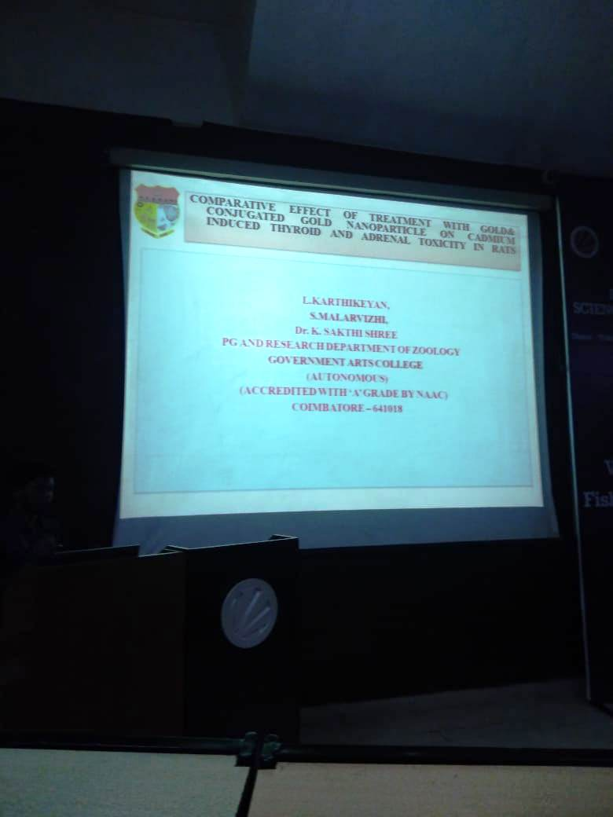
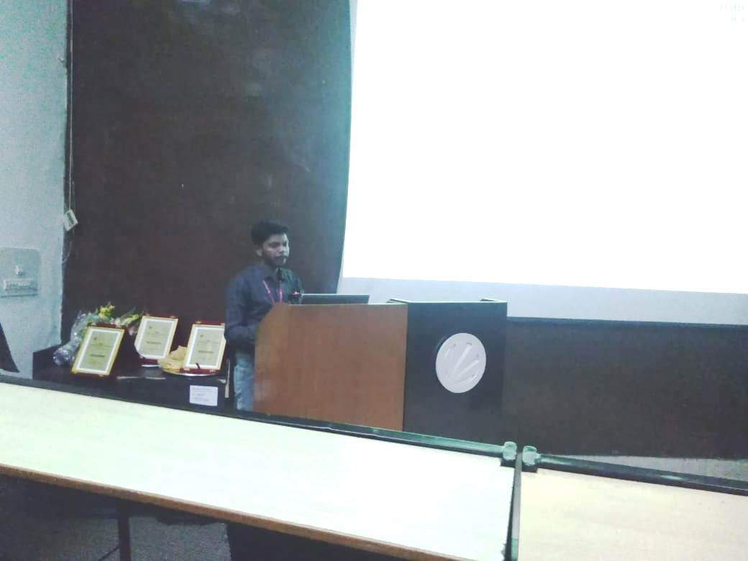
106th Indian Science Congress
Oral Presentation

Slide 10
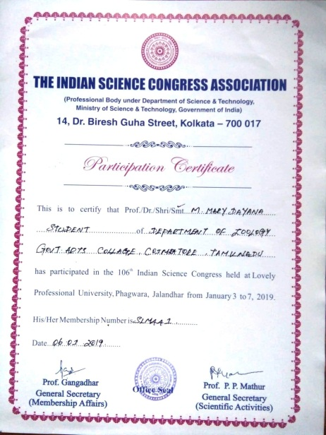
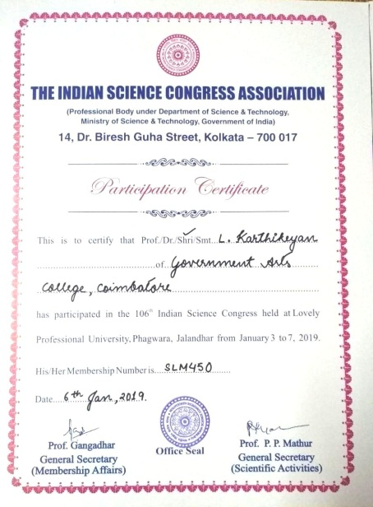
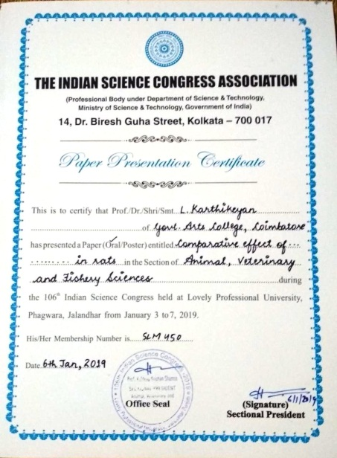
106th Indian Science Congress

Slide 11
